Slide 1
Disclaimer
This presentation is for educational purposes only and should not be used as a substitute for clinical judgement. GECKO aims to aid the practicing clinician by providing informed opinions regarding genetic services that have been developed in a rigorous and evidence-based manner. Physicians must use their own clinical judgement in addition to published articles and the information presented herein. GECKO assumes no responsibility or liability resulting from the use of information contained herein.

Slide 2
Land acknowledgment
We are meeting today from different Indigenous lands and treaty territories. Together, we offer our gratitude to Indigenous people for their careful stewardship of these lands in the past, and acknowledge their present contributions. Thank you for joining us from your territory. GECKO collaborators of this talk were located in Toronto and Ottawa-Outaouais.
The City of Toronto acknowledges that we are on the traditional territory of many nations including the Mississaugas of the Credit, the Anishnabeg, the Chippewa, the Haudenosaunee and the Wendat peoples and is now home to many diverse First Nations, Inuit and Métis peoples. The City also acknowledges that Toronto is covered by Treaty 13 signed with the Mississaugas of the Credit, and the Williams Treaties signed with multiple Mississaugas and Chippewa bands.
The Ottawa-Outaouais region which is located on the traditional and unceded territory of the Algonquin Anishnaabeg People
Relevant to this talk on genomic medicine, we are committed to making our educational materials on GECKO and in our presentations more appropriate for Indigenous cultures and world views - and to enable informed choice regarding genetic testing.

Slide 3
Genomics in your practice: Case-based pearls for everyday encounters with prenatal genomics
January 2023
Shawna Morrison MS CGC (genetic counsellor), June Carroll MD (family physician) and Judith Allanson MD (retired clinical geneticist)

Slide 4
Learning objectives
Following this session, you will be able to:
Summarize benefits and limitations of common genomic tests
Support patients through decision-making regarding genomic testing and results
Identify high quality genomics educational resources appropriate for primary care

Slide 5
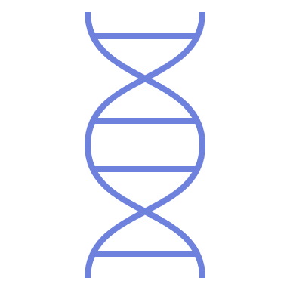
Clinical scenarios
Prenatal genomics
Highlighting NIPT
Notes:
We will take you through several clinical scenarios on the topics of PN genomics. Hereditary cancer, DTC GT and pull out the pearls for practice in each case

Slide 6
Clinical scenarios 1-3: prenatal
Do you provide prenatal care?
Do you find you provide more prenatal care than you used to?
Notes:
PSO 2019-2022 report https://www.bornontario.ca/en/pso/about-us/program-reports.aspx

Slide 7
Clinical scenario 1: healthy 33-year-old pregnant person
6 weeks gestational age by LMP
Excited but anxious
Wants all the information about ‘Down syndrome testing’

Slide 8
Clinical scenario 1: healthy 33-year-old pregnant person
6 weeks gestational age by LMP
Excited but anxious
Wants all the information about ‘Down syndrome testing’
Still undecided about testing (no test vs. self-pay NIPT vs. standard) and wants to discuss with partner
You provide all the paperwork for prenatal screening options in the first trimester

Slide 9
Prenatal genomic screening options in Ontario
Non-Invasive Prenatal Testing (NIPT) anytime after 9-10 weeks gestation
Enhanced First Trimester Screening (eFTS)
11-14 weeks
Ultrasound (with or without eFTS), nuchal translucency
Second Trimester Screening
(formerly MSS or Quad)
14-21 weeks
Ultrasound
18-22 weeks
No test
Notes:
What are the prenatal genomic screening options in ontario

Slide 10
How do Ontario’s first trimester screening tests compare?
 | Enhanced first trimester screening (eFTS) | Non-invasive prenatal testing (NIPT)
When can testing happen? | 11 weeks 2 days to 13 weeks 3 days | Anytime after 9-10 weeks
What is required? | Blood draw & Ultrasound by NT certified provider (sonographer, MD, nurse) | Blood draw
For twins? | No | Yes
Notes:
https://www.prenatalscreeningontario.ca/en/pso/for-providers-how-to-order/performance-of-prenatal-screening-tests.aspx#one
crown-rump length measurement (the measurement of the length of embryo from top of the head to the bottom of the torso) at the time of NT ultrasound is between 45 and 84 mm. This corresponds to a gestation between 11 weeks 2 days to 13 weeks 3 days.
Multiples NT only
.

Slide 11
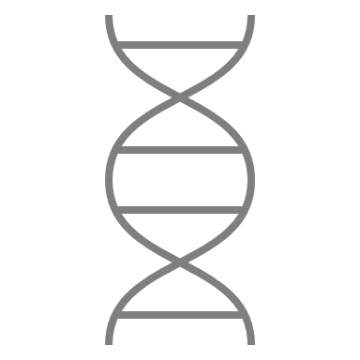
How do Ontario’s first trimester screening tests compare?
 | Enhanced first trimester screening (eFTS) | Non-invasive prenatal testing (NIPT)
What does the test use for analysis? | Maternal age Nuchal translucency measurement (fluid at the back of the fetus’ neck) Serum analytes (βhCG, PAPP-A, AFP, +/- PlGF)⁺ | Maternal age Small fragments of DNA circulating in maternal blood from the placenta representative of the fetus
What conditions are screened for? | Trisomy 21 (Down syndrome) Trisomy 18 (Edward syndrome) | Trisomy 21 (Down syndrome) Trisomy 18 (Edward syndrome) Trisomy 13 (Patau syndrome) Sex chromosome differences Other conditions*
⁺hCG -free beta Human Chorionic Gonadotropin; AFP- alpha-feto-protein; PAPP-A - Placenta-Associated Plasma Protein A; PlGF - Placenta Growth Factor
Notes:
https://www.prenatalscreeningontario.ca/en/pso/for-providers-how-to-order/performance-of-prenatal-screening-tests.aspx#one
crown-rump length measurement (the measurement of the length of embryo from top of the head to the bottom of the torso) at the time of NT ultrasound is between 45 and 84 mm. This corresponds to a gestation between 11 weeks 2 days to 13 weeks 3 days.
.

Slide 12
How do Ontario’s first trimester screening tests compare?
Performance | Enhanced first trimester screening (eFTS) | Non-invasive prenatal testing (NIPT)*
Detection rate for Down syndrome (Trisomy 21) | 89.0% | 99.5%
False positive rate | 6.3% | 0.1%
Detection rate for Edwards syndrome (Trisomy 18) | 85.0% | 96.0%
False positive rate | 0.2% | 0.04%
*OHIP-funded only, higher risk population
Notes:
https://www.prenatalscreeningontario.ca/en/pso/for-providers-how-to-order/performance-of-prenatal-screening-tests.aspx#one
*OHIP funded NIPT → higher risk = higher prevalence

Slide 13
Clinical scenario 1: healthy 33-year-old pregnant person
At 11 weeks’ gestation
You receive the negative (LOW RISK) NIPT results for this patient
Notes:
They opted to self- pay for NIPT as they were average risk

Slide 14
Clinical scenario 1: healthy 33-year-old pregnant person
At 11 weeks’ gestation
You receive the negative (LOW RISK) NIPT results for this patient
April 2019-March 2020 fiscal year:
146,947 pregnancies were recorded
17,802 NIPT screens were ordered in Ontario
(12% of pregnancies)
41% self-pay
59% OHIP funded
Notes:
They opted to self- pay for NIPT as they were average risk
In the April 2019 to March 2020 fiscal year, 146,947 pregnancies were recorded in the BORN Information
https://www.bornontario.ca/en/pso/resources/Remediated-PDFs-2020/PSO-Program-Report---FINAL-Dec-8-2021.pdf

Slide 15
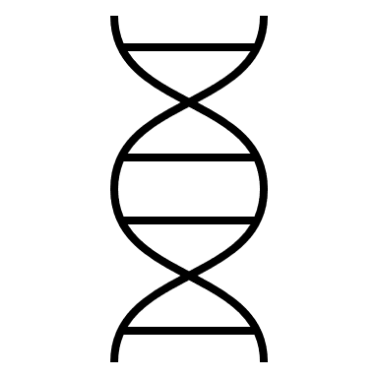
Non-Invasive Prenatal Testing (NIPT) OHIP funding criteria
Category I criteria (can be ordered by any physician or nurse practitioner)
Positive prenatal screening result for this pregnancy
Maternal age 40 years or older at the expected date of birth
in the context of in vitro fertilization, the maternal age is guided by the age at egg retrieval (whether own egg or donor egg)
Nuchal translucency (NT) measurement is ≥3.5mm
Personal history of a previous pregnancy or child with Trisomy 21, 18 or 13
Ongoing twin pregnancy
Notes:
Category II criteria (must be ordered by a genetics or maternal-fetal medicine specialist)
there are findings on ultrasound which are associated with an increased chance for trisomy 21, trisomy 18 or trisomy 13
there is chance for a sex-linked genetic condition
the ultrasound shows findings suggestive of a sex chromosome difference
the ultrasound shows findings suggestive of a disorder of sex determination
NIPT is NOT funded in Alberta, Saskatchewan
Unsure about NFLD

Slide 16
Clinical scenario 1: healthy 33-year-old pregnant person
At 11 weeks’ gestation
You receive the negative (LOW RISK) NIPT results for this patient
At 14 weeks’ gestation you receive the eFTS screen positive (HIGH RISK) result (1 in 200 risk for Down syndrome vs 1 in 634 age related risk at 33-years-old)
Notes:
They opted to self- pay for NIPT as they were average risk

Slide 17
Clinical scenario 1: healthy 33-year-old pregnant person
At 11 weeks’ gestation
You receive the negative (LOW RISK) NIPT results for this patient
Re-order eFTS
Reassure patient
Refer to genetics
Order STS
At 14 weeks’ gestation you receive the eFTS screen positive (HIGH RISK) result (1 in 200 risk for Down syndrome vs 1 in 634 age related risk at 33-years-old)
Notes:
They opted to self- pay for NIPT as they were average risk

Slide 18
Duplicate prenatal screening
Between 2016-2018, 6.0% of pregnancies had both NIPT and multiple marker screening (MMS)
The cohort for this analysis was all pregnancies with an EDB of September 1, 2016 to August 31, 2018. This represented a total of 284,687 pregnancies. PSO defines a record with MMS before cfDNA screening as a pregnancy that had a MMS report date before the sample for the cfDNA screening was collected, otherwise the records are classified as MMS at the same time or after cfDNA screening. Both publicly funded and self-paid cfDNA screens are included in this analysis.

Slide 19
Duplicate prenatal screening
Between 2016-2018, 6.0% of pregnancies had both NIPT and multiple marker screening (MMS)
In 58% of cases, MMS was performed before NIPT
The cohort for this analysis was all pregnancies with an EDB of September 1, 2016 to August 31, 2018. This represented a total of 284,687 pregnancies. PSO defines a record with MMS before cfDNA screening as a pregnancy that had a MMS report date before the sample for the cfDNA screening was collected, otherwise the records are classified as MMS at the same time or after cfDNA screening. Both publicly funded and self-paid cfDNA screens are included in this analysis.

Slide 20
Duplicate prenatal screening
Between 2016-2018, 6.0% of pregnancies had both NIPT and multiple marker screening (MMS)
In 58% of cases, MMS was performed before NIPT
In 42%, MMS was performed at the same time or after NIPT
The cohort for this analysis was all pregnancies with an EDB of September 1, 2016 to August 31, 2018. This represented a total of 284,687 pregnancies. PSO defines a record with MMS before cfDNA screening as a pregnancy that had a MMS report date before the sample for the cfDNA screening was collected, otherwise the records are classified as MMS at the same time or after cfDNA screening. Both publicly funded and self-paid cfDNA screens are included in this analysis.

Slide 21
Clinical scenario 1: healthy 33-year-old pregnant person
At 11 weeks’ gestation
You receive the negative (LOW RISK) NIPT results for this patient
Re-order eFTS
Reassure patient
Refer to genetics
Order STS
At 14 weeks’ gestation you receive the eFTS screen positive (HIGH RISK) result (1 in 200 risk for Down syndrome vs 1 in 634 age related risk at 33-years-old)
Notes:
They opted to self- pay for NIPT as they were average risk

Slide 22
Clinical scenario 1: healthy 33-year-old pregnant person
At 11 weeks’ gestation
You receive the negative (LOW RISK) NIPT results for this patient
Re-order eFTS
Reassure patient
Refer to genetics
Order STS
Re-order eFTS
Reassure patient
Refer to genetics
Order STS
At 14 weeks’ gestation you receive the eFTS screen positive (HIGH RISK) result (1 in 200 risk for Down syndrome vs 1 in 634 age related risk at 33-years-old)
Correct sequence of screening can:
Avoid confusion and anxiety
Allow for (potentially) funded second-tier screening
Notes:
They opted to self- pay for NIPT as they were average risk

Slide 23
Non-Invasive Prenatal Testing (NIPT) FAQ
Where is NIPT available?
Two Ontario-based laboratories:
Harmony® Prenatal Test | Dynacare
PanoramaTM NIPT | LifeLabs
Choosing a company
Ease of access to blood lab service
Twins AND IVF with donor egg or gestational surrogate (Harmony only)
Notes:
Lifelabs Panorama
Dynacare Harmony
OHIP funded NIPT requestions available on PSO site
PSO does not endorse any company

Slide 24
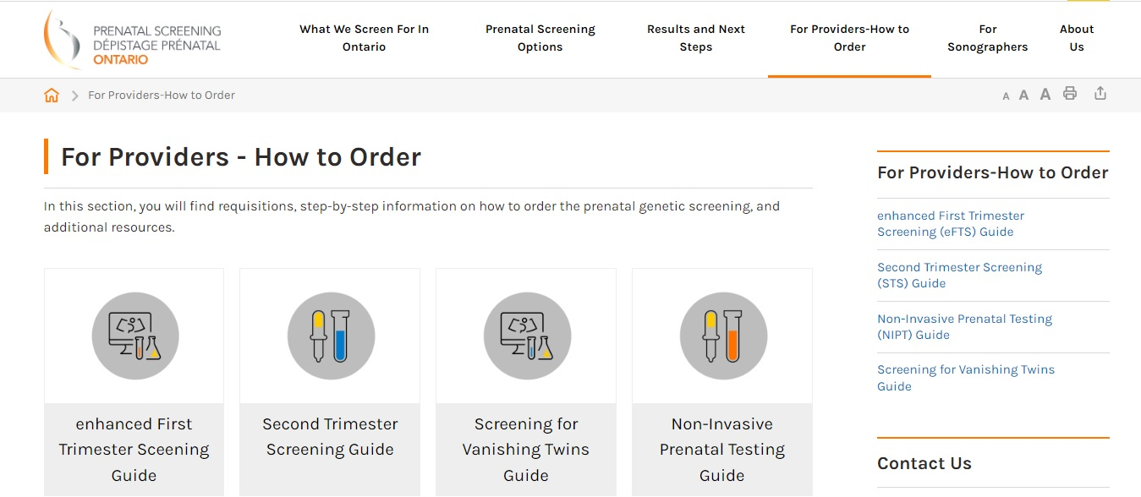
Non-Invasive Prenatal Testing (NIPT) FAQ
www.prenatalscreeningontario.ca > For Providers-How-To-Order
Notes:
ADD TO AFTER SLIDE 17
Here you will find OHIP funding criteria, information leaflets, links to requisitions, more on NIPT results

Slide 25
Non-Invasive Prenatal Testing (NIPT) FAQ
Where is NIPT available?
Two Ontario-based laboratories:
Harmony® Prenatal Test | Dynacare
PanoramaTM NIPT | LifeLabs
Choosing a company
Ease of access to blood lab service
Twins AND IVF with donor egg or gestational surrogate (Harmony only)
What is the cost?
OHIP-funding available for those who meet criteria for increased risk
Available for private pay, costs vary
550-795$
Notes:
Lifelabs Panorama
Dynacare Harmony
OHIP funded NIPT requestions available on PSO site
PSO does not endorse any company

Slide 26
Non-Invasive Prenatal Testing (NIPT) FAQ
Are there other options?
Some non-Canadian laboratories offer NIPT at lower cost (~99$)
Blood samples and personal health information sent out of the country
Data currently not returned to Ontario (quality control)

Slide 27
Non-Invasive Prenatal Testing (NIPT) FAQ
Are there other options?
Some non-Canadian laboratories offer NIPT at lower cost (~99$)
Blood samples and personal health information sent out of the country
Data currently not returned to Ontario (quality control)
Who should not have NIPT?
Vanishing twins, opt for NT and second trimester screening
Multiples (3+), opt for NT only
Notes:
No NIPT and eFTS in vanishing twin b/c can still be DNA/hormones from the twin that miscarried, and this can make the testing less accurate.

Slide 28
Non-Invasive Prenatal Testing (NIPT) FAQ
Where do I go for help?
NIPT company
Prenatal Screening Ontario
Call (!) a genetic counsellor is on-call Monday-Friday, 9-3

Slide 29
Clinical scenario 2: healthy 33-year-old pregnant person
6 weeks gestational age by LMP
Excited but anxious
Wants all the information about ‘Down syndrome testing’

Slide 30
Clinical scenario 2: healthy 33-year-old pregnant person
6 weeks gestational age by LMP
Excited but anxious
Wants all the information about ‘Down syndrome testing’
Wishes to proceed with self-pay NIPT
NIPT is positive (HIGH RISK) for Down syndrome
Notes:
There were a total of 17,802 NIPT screens ordered in the 2019-2020 fiscal year, 59% of which were funded by OHIP while 41% were self-paid by the pregnant individual.

Slide 31
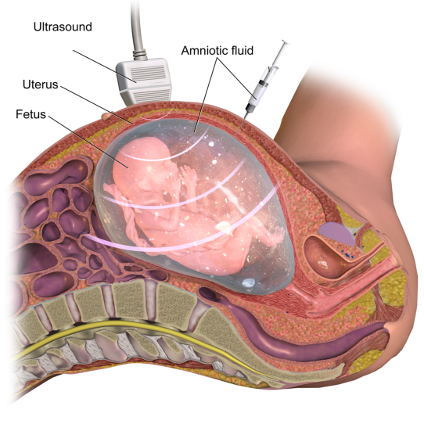
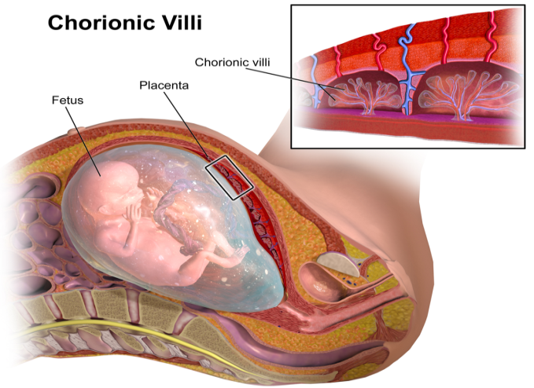
NIPT is a screening test.
Diagnostic testing is recommended before any irrevocable action.
Chorionic Villus Sampling (CVS),
11-13 weeks
Amniocentesis, 15+weeks
Notes:
NIPT LIMITATION AS A SCREENING TEST

Slide 32
NIPT is a screening test.
Diagnostic testing is recommended before any irrevocable action.
False positives can happen.
Notes:
NIPT LIMITATION AS A SCREENING TEST

Slide 33
NIPT is a screening test.
Diagnostic testing is recommended before any irrevocable action.
False positives can happen.
Confined placental mosaicism (present in 1-2% of first trimester placentas) may cause a false positive.
Notes:
NIPT LIMITATION AS A SCREENING TEST

Slide 34
NIPT is a screening test.
Diagnostic testing is recommended before any irrevocable action.
False positives can happen.
Confined placental mosaicism (present in 1-2% of first trimester placentas) may cause a false positive.
Notes:
NIPT LIMITATION AS A SCREENING TEST

Slide 35
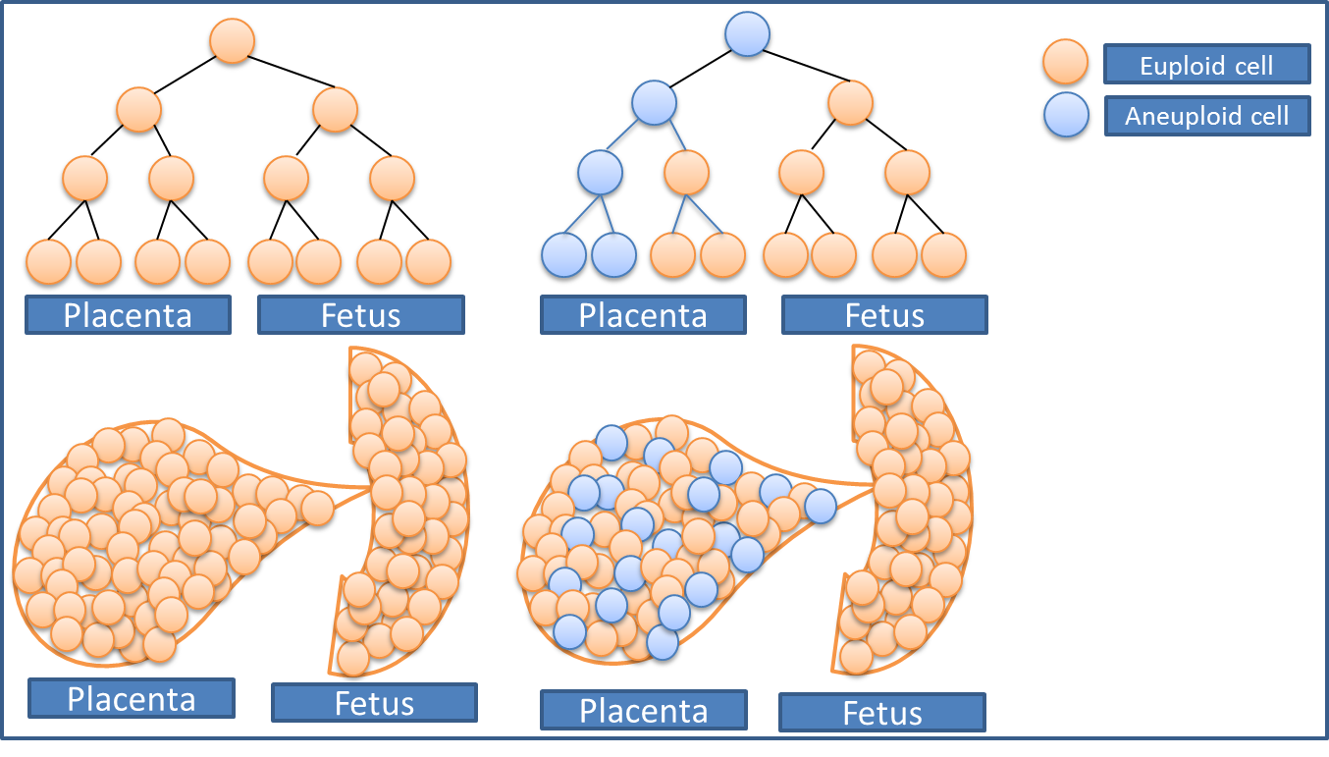
NIPT is a screening test.
Diagnostic testing is recommended before any irrevocable action.
Consider the positive predictive value (PPV) of the test for your patient and the condition they have screened positive for. PPV Prevalence
Confined placental mosaicism (present in 1-2% of first trimester placentas) may cause a false positive.
Notes:
PPV = (sensitivity x prevalence) / ((sensitivity x prevalence) + (1 – specificity)(1 – prevalence))

Slide 36
Clinical scenario 3: healthy 33-year-old pregnant person
At 14 weeks’ gestation you received the eFTS screen positive (HIGH RISK) result
(1 in 200 risk for Down syndrome vs 1 in 634 age related risk at 33-years-old)
Notes:
NEW SCENARIO #3

Slide 37
Clinical scenario 3: healthy 33-year-old pregnant person
At 14 weeks’ gestation you received the eFTS screen positive (HIGH RISK) result
(1 in 200 risk for Down syndrome vs 1 in 634 age related risk at 33-years-old)
NIPT was ordered as a contingent screen and was reported as negative (LOW RISK)
Notes:
There were a total of 17,802 NIPT screens ordered in the 2019-2020 fiscal year, 59% of which were funded by OHIP while 41% were self-paid by the pregnant individual.

Slide 38
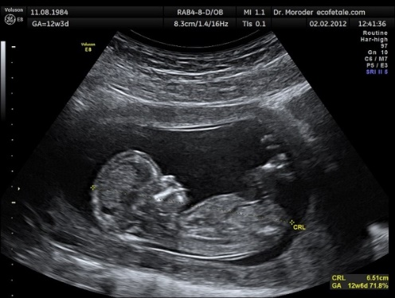
Clinical scenario 3: healthy 33-year-old pregnant person
At 14 weeks’ gestation you received the eFTS screen positive (HIGH RISK) result
(1 in 200 risk for Down syndrome vs 1 in 634 age related risk at 33-years-old)
NIPT was ordered as a contingent screen and was reported as negative (LOW RISK)
BUT
The eFTS also reported the nuchal translucency
was 4.2mm
Notes:
There were a total of 17,802 NIPT screens ordered in the 2019-2020 fiscal year, 59% of which were funded by OHIP while 41% were self-paid by the pregnant individual.

Slide 39
Clinical scenario 3: healthy 33-year-old pregnant person
At 14 weeks’ gestation you received the eFTS screen positive (HIGH RISK) result
(1 in 200 risk for Down syndrome vs 1 in 634 age related risk at 33-years-old)
NIPT was ordered as a contingent screen and was reported as negative (LOW RISK)
BUT
The eFTS also reported the nuchal translucency
was 4.2mm
Re-order eFTS
Reassure patient
Refer to genetics
Order STS
Notes:
There were a total of 17,802 NIPT screens ordered in the 2019-2020 fiscal year, 59% of which were funded by OHIP while 41% were self-paid by the pregnant individual.

Slide 40
NIPT is a screening test.
Not every genetic condition or congenital anomaly is screened for.
Notes:
NIPT LIMITATION AS A SCREENING TEST

Slide 41
NIPT is a screening test.
Not every genetic condition or congenital anomaly is screened for.
Even with a negative NIPT…
A large NT (above 3.5 mm) should be considered as a major marker for fetal chromosomal and structural anomalies and requires genetic counselling.
Audibert 2017 No 348. SOGC-CCMG Guideline
Offer ultrasound at 11-14wks and 18-20wks
Notes:
NIPT LIMITATION AS A SCREENING TEST

Slide 42
NIPT is a screening test.
Not every genetic condition or congenital anomaly is screened for.
Even with a negative NIPT…
A large NT (above 3.5 mm) should be considered as a major marker for fetal chromosomal and structural anomalies and requires genetic counselling.
Audibert 2017 No 348. SOGC-CCMG Guideline
Further clinical assessment for increased NT (>3.5mm) may include investigations to rule out or diagnose:
Cardiac anomaly → fetal echocardiogram
Congenital anomaly (e.g. diaphragmatic hernia ) → level II ultrasound
Syndrome (e.g. Noonan syndrome) → gene panel testing
Other genomic conditions → full karyotype + microdeletion/microduplication testing by array, whole exome/genome sequencing
Offer ultrasound at 11-14wks and 18-20wks
Notes:
NIPT LIMITATION AS A SCREENING TEST

Slide 43
NIPT is a screening test.
Not every genetic condition nor congenital anomaly is screened for.
Even with a negative NIPT…
A large NT (above 3.5 mm) should be considered as a major marker for fetal chromosomal and structural anomalies and requires genetic counselling.
Audibert 2017 No 348. SOGC-CCMG Guideline
Offer ultrasound at 11-14wks and 18-20wks
Notes:
When completing an NIPT requisition you have noticed, or even been asked by a patient about additional testing

Slide 44
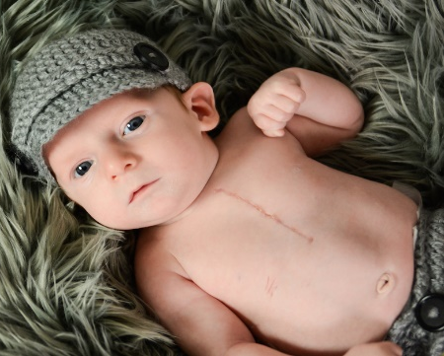
Microduplications and microdeletions are tiny genetic imbalances that may be associated with significant health and/or developmental problems despite their small size.
Clinically relevant microdeletions and duplications occur in ~1.7% of all structurally normal fetuses.
Incidence is independent of maternal age.
Cumulatively these disorders are common.
The combined at-birth incidence of the 5 most commonly offered microdeletion syndromes is approximately 1 in 1,000
e.g. 22q11.2 deletion syndrome, most common microdeletion, incidence of about 1 in 6,000 or higher, de novo in 90% of individuals
Notes:
Image International 22q11.2 Foundation
https://22q.org/
22q deletion syndrome
:
Individuals with 22q11.2 deletion syndrome (22q11.2DS) can present with a wide range of features that are highly variable, even within families. The major clinical manifestations of 22q11.2DS include congenital heart disease, particularly conotruncal malformations (ventricular septal defect, tetralogy of Fallot, interrupted aortic arch, and truncus arteriosus), palatal abnormalities (velopharyngeal incompetence, submucosal cleft palate, bifid uvula, and cleft palate), immune deficiency, characteristic facial features, and learning difficulties. Hearing loss can be sensorineural and/or conductive. Laryngotracheoesophageal, gastrointestinal, ophthalmologic, central nervous system, skeletal, and genitourinary anomalies also occur. Psychiatric illness and autoimmune disorders are more common in individuals with 22q11.2DS.
Other craniofacial features (e.g., hooded eyelids, ear anomalies, prominent nasal bridge, bulbous nose, micrognathia, asymmetric crying facies, craniosynostosis)
McDonald-McGinn DM, Hain HS, Emanuel BS, et al. 22q11.2 Deletion Syndrome. 1999 Sep 23 [Updated 2020 Feb 27]. In: Adam MP, Everman DB, Mirzaa GM, et al., editors. GeneReviews® [Internet]. Seattle (WA): University of Washington, Seattle; 1993-2023. Available from: https://www.ncbi.nlm.nih.gov/books/NBK1523/

Slide 45
There are too few studies to support the use of NIPT for expanded screening.
There are no guidelines – not considered standard of care to routinely offer.
Because these are low-prevalence disorders, false positive results are inevitable and the positive predictive value will be low.
→ Leading to an increase in invasive testing
Challenges to informed consent:
Lack of familiarity with rare conditions and limitations of the test
No province is currently funding.
Notes:
ROUTINE screening is not recommended
Because these are low-prevalence disorders, false positive results are inevitable and the positive predictive value will be low
Undermine benefit of NIPT reducing the number of women undergoing invasive testing
Uncertainty about the prenatal prevalence
Over 200 known pathogenic CNVs
Clinical presentation variable
Rare 1/5,000 to 1/50,000
Increases false +ve rate , decreases PPV
Positive result requires confirmation by diagnostic testing
Not recommended by any guidelines at this time
Informed consent:
Familiarity with rare conditions
Familiarity with testing limitations
E.g. 22q - 85% of individuals with 22qdeletion will have typical full deletion screened for by NIPT while 15% will have ‘nested’ deletions within the region; ~ 65-70% of Angelman syndrome is caused by (maternal) deletions at 15q11.2 screened for by NIPT while others will have various other genetic mechanisms

Slide 47
When ordering Non-Invasive Prenatal Testing (NIPT) consider:
Sequence of prenatal screening
OHIP-funding for those meeting high risk criteria, which includes twin pregnancies
It is a screen, not a diagnostic test
Higher accuracy versus traditional screening and additional conditions are screened, BUT not every possible condition
Ultrasound is still recommended at 11-14wks and 18-22wks
Screening for microdeletions/microduplications is not recommended
Notes:
Screening – FP do occur, analyzes placental DNA,

Slide 48
Prenatal Screening Ontario has all this information online and a genetic counsellor on-call to answer your and your patient’s questions
Additional NIPT considerations(e.g. sex chromosomes, limitations of testing such as the possibility of no result) are addressed in new GECKO resources

Slide 49
Resources
Prenatal Screening
www.prenatalscreeningontario.ca
Hereditary Cancer
www.cancercareontario.ca
Direct-to-consumer genomic testing
www.genome.gov
www.geneticseducation.ca
Your everyday genomics needs

Slide 50
Prenatal genetic screening
Prenatal screening programs vary across Canada, including methods and non-invasive prenatal testing funding criteria. Click on a link below to see what is available for your region.
Alberta
• Early Risk Assessment program (for those in Calgary area and southern Alberta) [Accessed Sept 2022]
• Non-invasive prenatal testing (NIPT) funding information [Accessed Sept 2022]
• With services for Northwest Territories and Nunavut (Kitimeot)
British Columbia Perinatal Services Prenatal Genetic Screening Program [Accessed Sept 2022]
• Non-invasive prenatal testing (NIPT) funding information [Accessed Sept 2022]
• With services for Yukon
Manitoba Prenatal genetic screening and diagnostic services [Accessed Sept 2022]
• Non-invasive prenatal testing (NIPT) funding information [Accessed Sept 2022]
• With services for Nunavut (Kivilliq)
Maritimes Prenatal Genetic Screening and Diagnosis services [Accessed Sept 2022]
• Non-invasive prenatal testing (NIPT) funding information [Accessed Sept 2022]
• Those in New Brunswick can discuss with maternal-fetal medicine specialist
Newfoundland and Labrador
• Contact your local genetics centre
Ontario Prenatal Screening Ontario [Accessed Sept 2022]
• Non-invasive prenatal testing (NIPT) funding information [Accessed Sept 2022]
• Wither services for Nunavut (Baffin)
Quebec Prenatal Screening Program [Accessed Sept 2022]
• Non-invasive prenatal testing funded as a Stage 2 test, see here for more [Accessed Sept 2022]
Saskatchewan Provincial program information[Accessed Sept 2022]
• Booklet for providers [Accessed Sept 2022]
• NIPT not currently publicly funded but is available as private pay
Notes:
Genetic services and test access and criteria for the Territories are generally administered through provincial programs
Alberta and Northwest Territories and Nunavut (Kitimeot)
British Colombia and Yukon
Manitoba and Nunavut (Kiviliq)
Ontario and Nunavut (Baffin)

Slide 51
GeneticsEducation.ca
www.geneticseducation.ca
Shawna Morrison MS CGC
morrison@cheo.on.ca
You
morrison@cheo.on.ca
Your local genetics clinic
eConsult
How do I order AJ screening?

