Slide 1
Disclaimer
This presentation is for educational purposes only and should not be used as a substitute for clinical judgement. GECKO aims to aid the practicing clinician by providing informed opinions regarding genetic services that have been developed in a rigorous and evidence-based manner. Physicians must use their own clinical judgement in addition to published articles and the information presented herein. GECKO assumes no responsibility or liability resulting from the use of information contained herein.

Slide 2
Land acknowledgment
We are meeting today from different Indigenous lands and treaty territories. Together, we offer our gratitude to Indigenous people for their careful stewardship of these lands in the past, and acknowledge their present contributions. Thank you for joining us from your territory. GECKO collaborators of this talk were located in Toronto and Ottawa-Outaouais.
The City of Toronto acknowledges that we are on the traditional territory of many nations including the Mississaugas of the Credit, the Anishnabeg, the Chippewa, the Haudenosaunee and the Wendat peoples and is now home to many diverse First Nations, Inuit and Métis peoples. The City also acknowledges that Toronto is covered by Treaty 13 signed with the Mississaugas of the Credit, and the Williams Treaties signed with multiple Mississaugas and Chippewa bands.
The Ottawa-Outaouais region which is located on the traditional and unceded territory of the Algonquin Anishnaabeg People
Relevant to this talk on genomic medicine, we are committed to making our educational materials on GECKO and in our presentations more appropriate for Indigenous cultures and world views - and to enable informed choice regarding genetic testing.

Slide 3
Genomics in your practice: Case-based pearls for everyday encounters with cancer and direct-to-consumer testing
January 2023
Shawna Morrison MS CGC (genetic counsellor), June Carroll MD (family physician) and Judith Allanson MD (retired clinical geneticist)

Slide 4
Learning objectives
Following this session, you will be able to:
Summarize benefits and limitations of common genomic tests
Support patients through decision-making regarding genomic testing and results
Identify high quality genomics educational resources appropriate for primary care

Slide 5
Clinical scenarios
Hereditary cancer
Updates to testing
Prenatal genomics
Highlighting NIPT
Direct-to- consumer genomic testing
Points to consider
Notes:
We will take you through several clinical scenarios on the topics of PN genomics. Hereditary cancer, DTC GT and pull out the pearls for practice in each case

Slide 6
Clinical scenario 4: hereditary cancer
Do you feel confident identifying patients who would benefit from referral to genetics?
And reassuring those who would not?

Slide 7
Clinical scenario 4: healthy 45-year-old female
Expresses relief to you following the receipt of direct-to- consumer genomic test results
Because she does not carry “the breast cancer gene”

Slide 8
Direct-to-consumer genomic testing (DTC-GT) is advertised and offered to patients without the involvement of a healthcare provider in the typical healthcare setting.
Available online, globally for 250$ -700$.
Provide DNA sample (saliva) and a report is available online.
Notes:
What is DTC?
Tandy-Connor S, Guiltinan J, Krempely K, LaDuca H, Reineke P, Gutierrez S, Gray P, Tippin Davis B. False-positive results released by direct-to-consumer genetic tests highlight the importance of clinical confirmation testing for appropriate patient care. Genet Med. 2018 Dec;20(12):1515-1521. doi: 10.1038/gim.2018.38. Epub 2018 Mar 22. PMID: 29565420; PMCID: PMC6301953.
Our analyses indicated that 40% of variants in a variety of genes reported in DTC raw data were false positives. In addition, some variants designated with the "increased risk" classification in DTC raw data or by a third-party interpretation service were classified as benign at Ambry Genetics as well as several other clinical laboratories, and are noted to be common variants in publicly available population frequency databases.
250$ 23and Me; 500$ Nutigenomics; 700$ PillCheck/GenesYouIn

Slide 9
What kind of results do DTC-GT companies report?

Slide 10
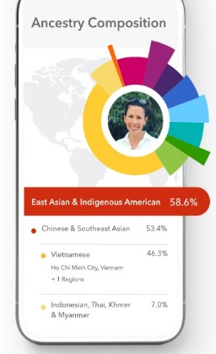
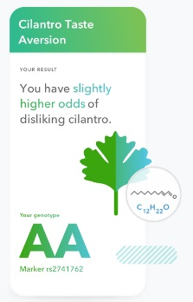
Ancestry
Traits/Wellness
Notes:
Think of the types of results as fitting into four or so buckets
Wellness: caffeine response, alcohol flush, allergies, muscle composition, lactose intolerance
Carrier testing – may be useful to couples who find out they are both carriers of the same condition
https://www.genomicseducation.hee.nhs.uk/blog/nutrigenomics-your-genes-diet-health-what-you-need-to-know/ Nutrigenomics
Multifactorial disorders and genome-wide association studies (GWAS): GWAS are case-control studies which examine many common variations in our genetic code (single nucleotide polymorphisms [SNPs]). They compare large groups of individuals (unaffected controls versus individuals with symptoms of a specific disease or those experiencing a particular medication response) in an attempt to distinguish between non-harmful changes in the DNA code and pathogenic, disease causing/predisposing changes. SNPs (pronounced ‘snips’) are the most common type of genetic variation. Each SNP represents a difference in a single DNA building block, a nucleotide. SNPs occur normally in an individual’s genome about once in every 300 nucleotides, thus there are about 10 million SNPs in the human genome.
Odds ratios and relative risks are used to categorize an individual as at increased risk (higher than average), average (general population risk), or decreased risk (lower than average). Results from GWAS may be used to report an individual’s risk for cancer, heart disease or diabetes. Test laboratories use variable literature sources, data set and technologies for testing and variant classification which adds complexity to interpretation.
Mendelian disorders and ethnicity-specific testing or next generation sequencing: Single gene disorders (e.g. cystic fibrosis, HFE-associated hemochromatosis, BRCA-associated hereditary breast and ovarian cancer syndrome) are often screened for by targeting only ethnicity-based gene variations. For example, screening for mutations in the BRCA1 and BRCA2 genes is limited to the three commonly found in individuals of Ashkenazi Jewish ethnicity, regardless of the consumer’s reported ethnicity. This means that not all clinically relevant mutations or even genes are necessarily included in analysis; possibly resulting in false reassurance with negative results⁷.This is of particular importance where there is a known family history.
Additionally next generation sequencing (NGS) may be employed, where the entire coding region of a gene is sequenced (read) looking for significant variation as compared to a reference sequence. While some variations are well known to be either pathogenic or benign, some require expert analysis by a genomic specialist. Genetic changes that are only weakly associated with disease may be reported, possibly leading to anxiety or inappropriate additional testing⁷. Additionally, due to variability in interpretation, there is the possibility of conflicting risk interpretations between companies.

Slide 11
Ancestry
Traits/Wellness
Carrier testing
Targeted and ethnicity-specific i.e. narrowly applicable
Notes:
Think of the types of results as fitting into four or so buckets
Wellness: caffeine response, alcohol flush, allergies, muscle composition, lactose intolerance
Carrier testing – may be useful to couples who find out they are both carriers of the same condition
https://www.genomicseducation.hee.nhs.uk/blog/nutrigenomics-your-genes-diet-health-what-you-need-to-know/ Nutrigenomics
Multifactorial disorders and genome-wide association studies (GWAS): GWAS are case-control studies which examine many common variations in our genetic code (single nucleotide polymorphisms [SNPs]). They compare large groups of individuals (unaffected controls versus individuals with symptoms of a specific disease or those experiencing a particular medication response) in an attempt to distinguish between non-harmful changes in the DNA code and pathogenic, disease causing/predisposing changes. SNPs (pronounced ‘snips’) are the most common type of genetic variation. Each SNP represents a difference in a single DNA building block, a nucleotide. SNPs occur normally in an individual’s genome about once in every 300 nucleotides, thus there are about 10 million SNPs in the human genome.
Odds ratios and relative risks are used to categorize an individual as at increased risk (higher than average), average (general population risk), or decreased risk (lower than average). Results from GWAS may be used to report an individual’s risk for cancer, heart disease or diabetes. Test laboratories use variable literature sources, data set and technologies for testing and variant classification which adds complexity to interpretation.
Mendelian disorders and ethnicity-specific testing or next generation sequencing: Single gene disorders (e.g. cystic fibrosis, HFE-associated hemochromatosis, BRCA-associated hereditary breast and ovarian cancer syndrome) are often screened for by targeting only ethnicity-based gene variations. For example, screening for mutations in the BRCA1 and BRCA2 genes is limited to the three commonly found in individuals of Ashkenazi Jewish ethnicity, regardless of the consumer’s reported ethnicity. This means that not all clinically relevant mutations or even genes are necessarily included in analysis; possibly resulting in false reassurance with negative results⁷.This is of particular importance where there is a known family history.
Additionally next generation sequencing (NGS) may be employed, where the entire coding region of a gene is sequenced (read) looking for significant variation as compared to a reference sequence. While some variations are well known to be either pathogenic or benign, some require expert analysis by a genomic specialist. Genetic changes that are only weakly associated with disease may be reported, possibly leading to anxiety or inappropriate additional testing⁷. Additionally, due to variability in interpretation, there is the possibility of conflicting risk interpretations between companies.

Slide 12
Ancestry
Traits/Wellness
Carrier testing
Pharmacogenomics
How one’s genomic make-up affects response to
medications
Slow/No
Normal
Ultra/rapid
Notes:
Pharmacogenomics has been shown to be of some clinical utility in some cases,

Slide 13
Ancestry
Traits/Wellness
Carrier testing
Pharmacogenomics
Disease risk
Notes:
Multifactorial disorders and genome-wide association studies (GWAS): GWAS are case-control studies which examine many common variations in our genetic code (single nucleotide polymorphisms [SNPs]). They compare large groups of individuals (unaffected controls versus individuals with symptoms of a specific disease or those experiencing a particular medication response) in an attempt to distinguish between non-harmful changes in the DNA code and pathogenic, disease causing/predisposing changes. SNPs (pronounced ‘snips’) are the most common type of genetic variation. Each SNP represents a difference in a single DNA building block, a nucleotide. SNPs occur normally in an individual’s genome about once in every 300 nucleotides, thus there are about 10 million SNPs in the human genome.
Odds ratios and relative risks are used to categorize an individual as at increased risk (higher than average), average (general population risk), or decreased risk (lower than average). Results from GWAS may be used to report an individual’s risk for cancer, heart disease or diabetes. Test laboratories use variable literature sources, data set and technologies for testing and variant classification which adds complexity to interpretation.
Mendelian disorders and ethnicity-specific testing or next generation sequencing: Single gene disorders (e.g. cystic fibrosis, HFE-associated hemochromatosis, BRCA-associated hereditary breast and ovarian cancer syndrome) are often screened for by targeting only ethnicity-based gene variations. For example, screening for mutations in the BRCA1 and BRCA2 genes is limited to the three commonly found in individuals of Ashkenazi Jewish ethnicity, regardless of the consumer’s reported ethnicity. This means that not all clinically relevant mutations or even genes are necessarily included in analysis; possibly resulting in false reassurance with negative results⁷.This is of particular importance where there is a known family history.
Additionally next generation sequencing (NGS) may be employed, where the entire coding region of a gene is sequenced (read) looking for significant variation as compared to a reference sequence. While some variations are well known to be either pathogenic or benign, some require expert analysis by a genomic specialist. Genetic changes that are only weakly associated with disease may be reported, possibly leading to anxiety or inappropriate additional testing⁷. Additionally, due to variability in interpretation, there is the possibility of conflicting risk interpretations between companies.

Slide 14
Ancestry
Traits/Wellness
Carrier testing
Pharmacogenomics
Disease risk
Multifactorial
Mendelian
Type 2 Diabetes
Celiac disease
BRCA1 and BRCA2
Familial hypercholesterolemia
Notes:
Multifactorial disorders and genome-wide association studies (GWAS): GWAS are case-control studies which examine many common variations in our genetic code (single nucleotide polymorphisms [SNPs]). They compare large groups of individuals (unaffected controls versus individuals with symptoms of a specific disease or those experiencing a particular medication response) in an attempt to distinguish between non-harmful changes in the DNA code and pathogenic, disease causing/predisposing changes. SNPs (pronounced ‘snips’) are the most common type of genetic variation. Each SNP represents a difference in a single DNA building block, a nucleotide. SNPs occur normally in an individual’s genome about once in every 300 nucleotides, thus there are about 10 million SNPs in the human genome.
Odds ratios and relative risks are used to categorize an individual as at increased risk (higher than average), average (general population risk), or decreased risk (lower than average). Results from GWAS may be used to report an individual’s risk for cancer, heart disease or diabetes. Test laboratories use variable literature sources, data set and technologies for testing and variant classification which adds complexity to interpretation.
Mendelian disorders and ethnicity-specific testing or next generation sequencing: Single gene disorders (e.g. cystic fibrosis, HFE-associated hemochromatosis, BRCA-associated hereditary breast and ovarian cancer syndrome) are often screened for by targeting only ethnicity-based gene variations. For example, screening for mutations in the BRCA1 and BRCA2 genes is limited to the three commonly found in individuals of Ashkenazi Jewish ethnicity, regardless of the consumer’s reported ethnicity. This means that not all clinically relevant mutations or even genes are necessarily included in analysis; possibly resulting in false reassurance with negative results⁷.This is of particular importance where there is a known family history.
Additionally next generation sequencing (NGS) may be employed, where the entire coding region of a gene is sequenced (read) looking for significant variation as compared to a reference sequence. While some variations are well known to be either pathogenic or benign, some require expert analysis by a genomic specialist. Genetic changes that are only weakly associated with disease may be reported, possibly leading to anxiety or inappropriate additional testing⁷. Additionally, due to variability in interpretation, there is the possibility of conflicting risk interpretations between companies.
FROM GECKO’s DTC ON THE RUN

Slide 15
Recent systematic review showed of healthcare providers (PCP, specialists, and genomics) over the last 10 years showed persistent concerns around:
the clinical utility and validity (accuracy and reliability)
privacy of genomic information
ignoring family history in the interpretation
results being inconsequential to patients

Slide 16
Consumer motivations
control
adoption
information
health
curiosity
family discussion
lifestyle
Notes:
Main motivation for DTC: see word cloud
Intention to discuss with PCPs ambivalent to high, and higher when perceived clinical utility e.g. related to famhx

Slide 17
Clinical scenario 4: healthy 45-year-old female
Expresses relief to you following the receipt of DTC-GT results
Because she does not carry “the breast cancer gene”
What are the next steps with this patient?
Notes:
Explore her motivations for pursuing DTC?
What are her concerns for the BRCA gene?

Slide 18
d.60s
d.90s
d.82
d.50s
CRC
dx. 60s
BrCA dx. 45
95
82
74
d.78
d.90
d.85
Prostate dx. 69
BrCA dx. 60s
BrCA dx. 65
45
2
2017
2019

Slide 19
d.60s
d.90s
d.82
d.50s
CRC
dx. 60s
BrCA dx. 45
95
82
74
d.78
d.90
d.85
Prostate dx. 69
BrCA dx. 60s
BrCA dx. 65
45
2
2017
2019

Slide 20
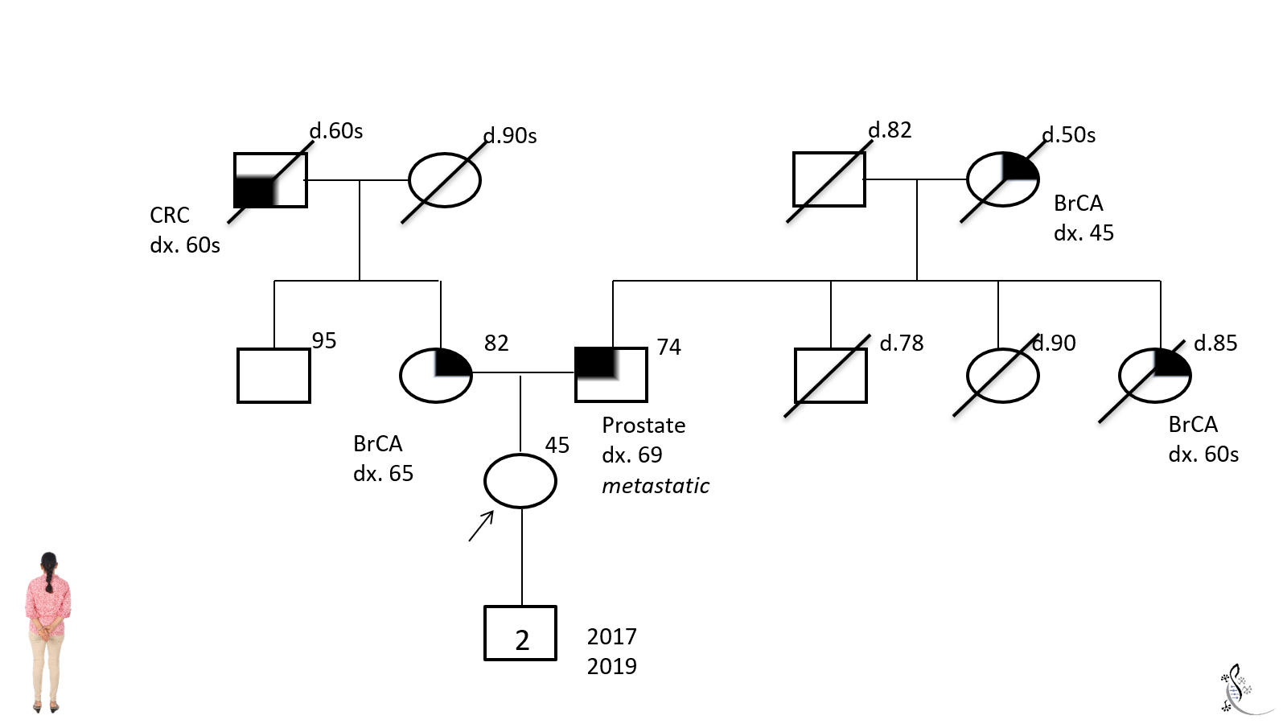
d.60s
d.90s
d.82
d.50s
CRC
dx. 60s
BrCA dx. 45
95
82
74
d.78
d.90
d.85
Prostate dx. 69
metastatic
BrCA dx. 60s
BrCA dx. 65
45
2
2017
2019

Slide 21
d.60s
d.90s
d.82
d.50s
CRC
dx. 60s
BrCA dx. 45
What can you tell her about her DTC-GT results?
She can be reassured, most her family’s breast cancer is on her father’s side
She still needs genetic testing
Consider referral to genetics to discuss family history
95
82
74
d.78
d.90
d.85
Prostate dx. 69
metastatic
BrCA dx. 60s
BrCA dx. 65
45
2
2017
2019
Notes:
What can you tell her about her direct-to-consumer genomic test result?

Slide 24
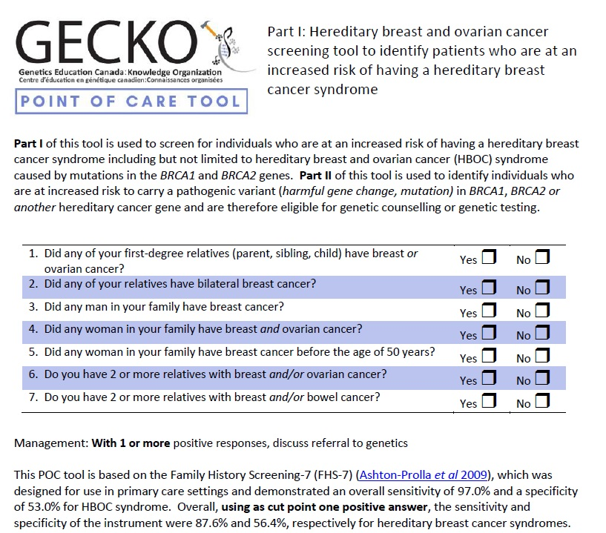
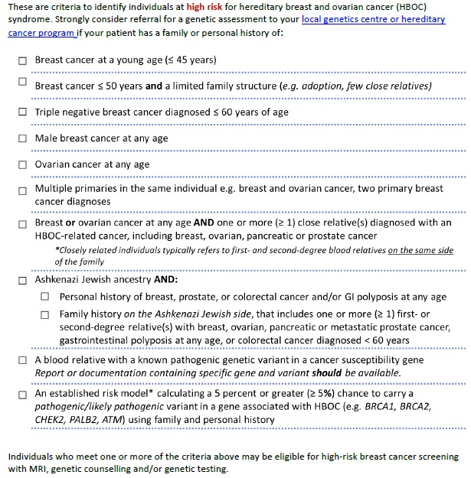
Notes:
Assessing HBOC
POC on the GECKO site

Slide 25
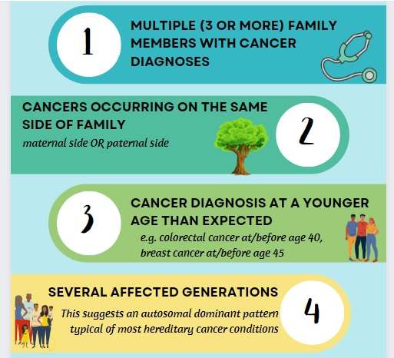
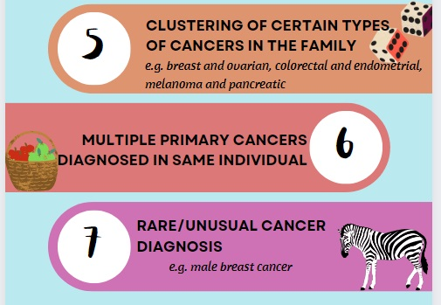
Hereditary cancer personal/family history red flags
Relationship to patient
Cancer type
Age of diagnosis

Slide 26
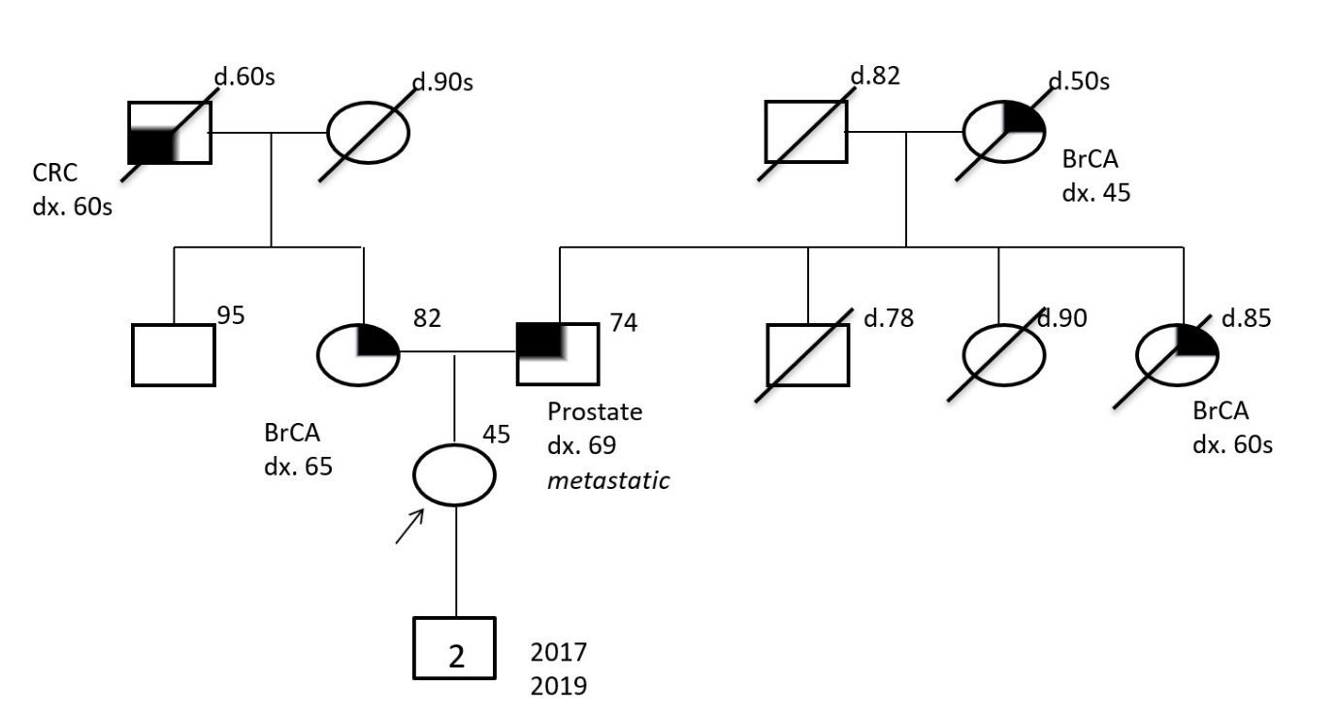
As an unaffected individual, she is not likely to meet provincial criteria for genetic testing
The best person to offer genetic testing to is the youngest, affected individual
Another family member (e.g. father) may be offered genetic testing
Notes:
IBIS: The Tyrer-Cuzick model is a breast cancer risk assessment tool incorporating
family history,
endogenous hormonal factors,
benign disease,
risk factors such as age and body mass index,
genetic factors (including BRCA) into a single statistical model.
The Tyrer-Cuzick model has been shown in independent studies to be the most consistently accurate when compared with other available risk assessment models. The model has been incorporated into a computer programme, the IBIS software that gives a personalised risk estimate. IBIS is available for non-exclusive licensing for stand-alone use or for incorporation into broader software platforms.

Slide 27
As an unaffected individual, she is not likely to meet provincial criteria for genetic testing
The best person to offer genetic testing to is the youngest, affected individual
Another family member (e.g. father) may be offered genetic testing
Her lifetime breast cancer risk is elevated
2-fold increase in lifetime risk for women with an affected first degree relative
Larger increase among those with a first-degree relative diagnosed before age 50
Personal factors impact risk e.g. breast density, previous history of benign breast disease
Notes:
IBIS: The Tyrer-Cuzick model is a breast cancer risk assessment tool incorporating
family history,
endogenous hormonal factors,
benign disease,
risk factors such as age and body mass index,
genetic factors (including BRCA) into a single statistical model.
The Tyrer-Cuzick model has been shown in independent studies to be the most consistently accurate when compared with other available risk assessment models. The model has been incorporated into a computer programme, the IBIS software that gives a personalised risk estimate. IBIS is available for non-exclusive licensing for stand-alone use or for incorporation into broader software platforms.

Slide 28
As an unaffected individual, she is not likely to meet provincial criteria for genetic testing
The best person to offer genetic testing to is the youngest, affected individual
Another family member (e.g. father) may be offered genetic testing
Her lifetime breast cancer risk is elevated
2-fold increase in lifetime risk for women with an affected first degree relative
Larger increase among those with a first-degree relative diagnosed before age 50
Personal factors impact risk e.g. breast density, previous history of benign breast disease
She likely qualifies for high risk cancer screening (e.g. MRI and mammogram)
Notes:
IBIS: The Tyrer-Cuzick model is a breast cancer risk assessment tool incorporating
family history,
endogenous hormonal factors,
benign disease,
risk factors such as age and body mass index,
genetic factors (including BRCA) into a single statistical model.
The Tyrer-Cuzick model has been shown in independent studies to be the most consistently accurate when compared with other available risk assessment models. The model has been incorporated into a computer programme, the IBIS software that gives a personalised risk estimate. IBIS is available for non-exclusive licensing for stand-alone use or for incorporation into broader software platforms.

Slide 29
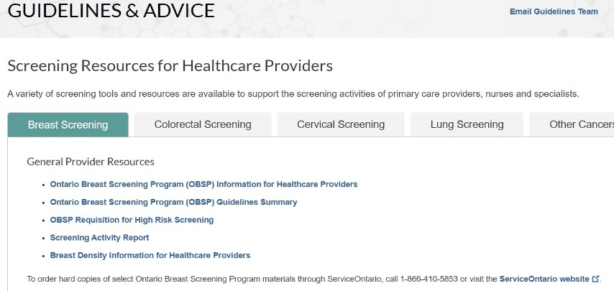

Slide 30
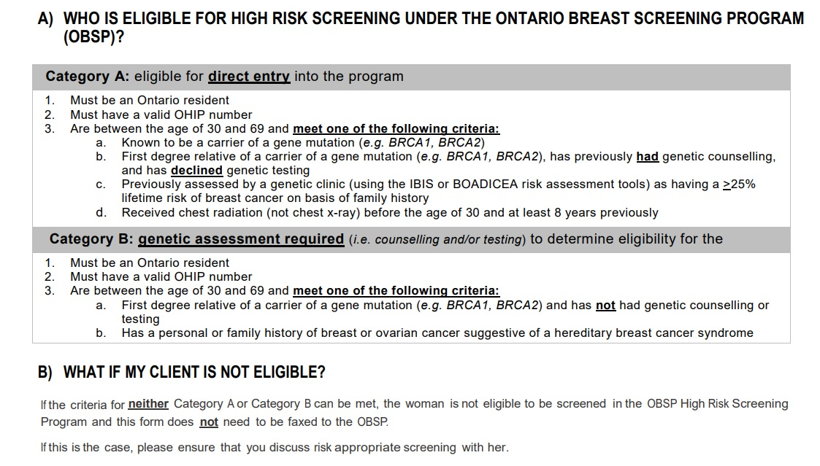

Slide 32
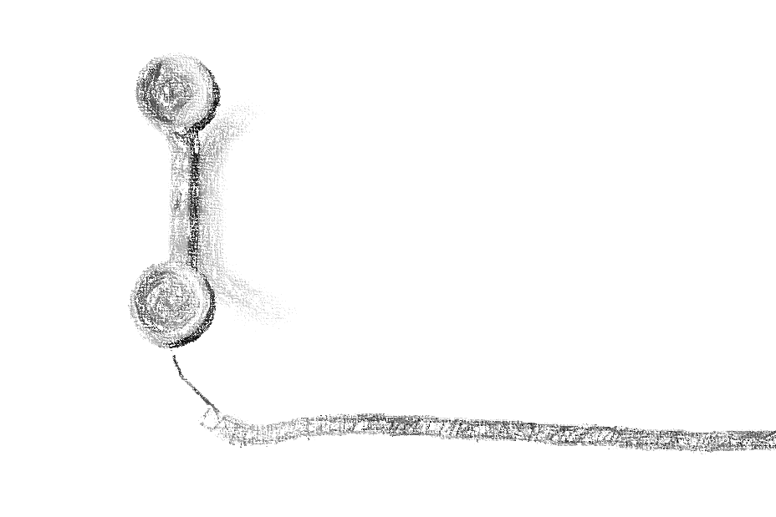
PATIENT
Refer to your local genetics clinic for an assessment and recommendations or Call and speak to the genetic counsellor on call
Notes:
Outside of age requirement, DND or Nunavut coverage

Slide 33
Clinical scenario 4: healthy 45-year-old female
Expresses relief to you following the receipt of DTC-GT results
Because she does not carry “the breast cancer gene”
What can you tell her about her DTC-GT results?
She can be reassured, most her family’s breast cancer is on her father’s side
She still needs genetic testing
Consider referral to genetics to discuss family history
What can you tell her about her DTC-GT results?
She can be reassured, most her family’s breast cancer is on her father’s side
She still needs genetic testing
Consider referral to genetics to discuss family history

Slide 34
Clinical scenario 4: healthy 45-year-old female
Expresses relief to you following the receipt of DTC-GT results
Because she does not carry “the breast cancer gene”
Patient is referred to genetics and waiting for her appointment, what can you tell her about her DTC-GT results?

Slide 35
All cancer is genetic

Slide 36
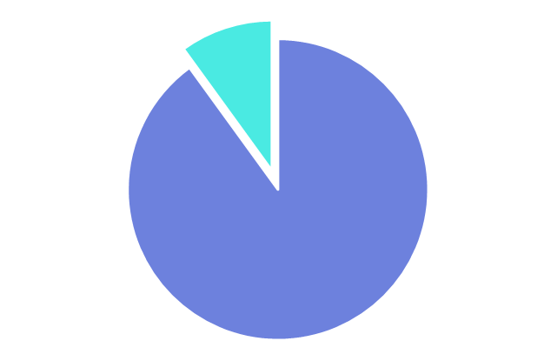
All cancer is genetic
BUT only 5-10% of breast cancer is hereditary and can be attributed to an inherited high or moderate risk-associated gene change
BRCA1
BRCA2
PALB2
CHECK2
ATM

Slide 37
Direct-to-consumer genomic testing for hereditary breast (and ovarian) cancer
Notes:
Life Labs 600-729$
Dyncare offers Color genomics 589$ 30 genes – HCP
Invitae 250 $ plus more for counselling – can order online with telehealth MD and get spit kit in mail
https://geneticliteracyproject.org/glps-aggregation-of-articles-and-use-of-images-under-the-fair-use-copyright-exception/
https://geneticliteracyproject.org/2019/07/26/knowledge-without-context-why-consumer-genetic-tests-can-spark-needless-fears-behavioral-changes/#.WPdeNczVIaI.twitter

Slide 38
Direct-to-consumer genomic testing for hereditary breast (and ovarian) cancer
Generally limited only to the highly penetrant BRCA1 and BRCA2 genes and the three common BRCA pathogenic variants found in Ashkenazi Jewish individuals
Pathogenic variant = harmful gene change = formerly mutation
Notes:
Life Labs 600-729$
Dyncare offers Color genomics 589$ 30 genes – HCP
Invitae 250 $ plus more for counselling – can order online with telehealth MD and get spit kit in mail
https://geneticliteracyproject.org/glps-aggregation-of-articles-and-use-of-images-under-the-fair-use-copyright-exception/
https://geneticliteracyproject.org/2019/07/26/knowledge-without-context-why-consumer-genetic-tests-can-spark-needless-fears-behavioral-changes/#.WPdeNczVIaI.twitter

Slide 39
Direct-to-consumer genomic testing for hereditary breast (and ovarian) cancer
Generally limited only to the highly penetrant BRCA1 and BRCA2 genes and the three common BRCA pathogenic variants found in Ashkenazi Jewish individuals
Negative result does not eliminate family history associated risk
There are other:
BRCA gene pathogenic variants
high risk breast cancer syndromes (e.g. Cowden syndrome)
moderate risk breast cancer genes (e.g. ATM, CHEK2)
Pathogenic variant = harmful gene change = formerly mutation
Notes:
Life Labs 600-729$
Dyncare offers Color genomics 589$ 30 genes – HCP
Invitae 250 $ plus more for counselling – can order online with telehealth MD and get spit kit in mail
https://geneticliteracyproject.org/glps-aggregation-of-articles-and-use-of-images-under-the-fair-use-copyright-exception/
https://geneticliteracyproject.org/2019/07/26/knowledge-without-context-why-consumer-genetic-tests-can-spark-needless-fears-behavioral-changes/#.WPdeNczVIaI.twitter

Slide 40
Direct-to-consumer genomic testing for hereditary breast (and ovarian) cancer
Generally limited only to the highly penetrant BRCA1 and BRCA2 genes and the three common BRCA pathogenic variants found in Ashkenazi Jewish individuals
Negative result does not eliminate family history associated risk
There are other:
BRCA gene pathogenic variants
high risk breast cancer syndromes (e.g. Cowden syndrome)
moderate risk breast cancer genes (e.g. ATM, CHEK2)
Positive result should be confirmed in a clinical laboratory
Pathogenic variant = harmful gene change = formerly mutation
Notes:
Life Labs 600-729$
Dyncare offers Color genomics 589$ 30 genes – HCP
Invitae 250 $ plus more for counselling – can order online with telehealth MD and get spit kit in mail
https://geneticliteracyproject.org/glps-aggregation-of-articles-and-use-of-images-under-the-fair-use-copyright-exception/
https://geneticliteracyproject.org/2019/07/26/knowledge-without-context-why-consumer-genetic-tests-can-spark-needless-fears-behavioral-changes/#.WPdeNczVIaI.twitter

Slide 41
Hereditary cancer testing in Ontario
Notes:
There were only criteria for HBOC and Lynch
Expanded in disease site, the stringency, lowering age of dx and mutation probabiliy

Slide 42
Hereditary cancer testing in Ontario
Clinical testing criteria have expanded (Oct 2022)
Hereditary breast and ovarian cancer syndrome
Lynch syndrome
Hereditary breast, ovarian cancer syndrome
Lynch syndrome
Hereditary prostate cancer
Hereditary endometrial cancer
Hereditary gastrointestinal
… and more
Breast cancer diagnosed <35y
Breast cancer diagnosed <45y
Likelihood of a pathogenic variant 10%
Likelihood of a pathogenic variant 5%
New personal history
Personal diagnosis of metastatic prostate cancer, any age
Personal diagnosis pancreatic cancer, any age
Personal history of ≥3 primary malignant melanomas
Notes:
There were only criteria for HBOC and Lynch
Expanded in disease site, the stringency, lowering age of dx and mutation probabiliy

Slide 43
Hereditary cancer testing in Ontario
Clinical testing criteria have expanded (Oct 2022)
Testing is by large gene panels targeted for disease sites or syndromes
Syndrome / Disease Site | Associated Genes
Hereditary Breast/ Ovarian/ Prostate | ATM, BARD1, BRCA1, BRCA2, BRIP1, CDH1, CHEK2, EPCAM, HOXB13, MLH1, MSH2, MSH6, PALB2, PMS2, PTEN, RAD51C, RAD51D, STK11, TP53
Lynch Syndrome | EPCAM, MLH1, MSH2, MSH6, PMS2
Hereditary Endometrial | BRCA1, BRCA2, EPCAM, MLH1, MSH2, MSH6, PMS2, POLD1, POLE, PTEN
Hereditary GI (Lynch Syndrome, Gastric, Pancreas, Polyposis) | APC, ATM, BMPR1A, BRCA1, BRCA2, CDH1, CDKN2A, CHEK2, CTNNA1, EPCAM, GALNT12, GREM1, MLH1, MLH3, MSH2, MSH3, MSH6, MUTYH, NTHL1, PALB2, PMS2, POLD1, POLE, PTEN, RNF43, RPS20, SDHB, SDHD, SMAD4, STK11, TP53
Pancreas (Adenocarcinoma) | ATM, BRCA1, BRCA2, CDKN2A, EPCAM, MLH1, MSH2, MSH6, PALB2, PMS2, STK11, TP53
Familial Melanoma | BAP1, BRCA2, CDK4, CDKN2A, MITF, POT1, PTEN
Notes:
Previously was limited to one or two genes
https://www.cancercareontario.ca/en/guidelines-advice/types-of-cancer/70161

Slide 44
Hereditary cancer testing in Ontario
Clinical testing criteria have expanded (Oct 2022)
Testing is by large gene panels targeted for disease sites or syndromes
Includes high and moderate risk genes
BRCA1
Absolute lifetime risk for breast cancer: >60%
CHEK2
Absolute lifetime risk for breast cancer 15-40%
Notes:
Previously was limited to one or two genes
https://www.cancercareontario.ca/en/guidelines-advice/types-of-cancer/70161

Slide 45
Hereditary cancer testing in Ontario
Clinical genomic testing has expanded (Oct 2022)
Testing is by gene panel targeted for disease sites or syndromes
Includes high and moderate risk genes
As well as genes associated with multiple cancer syndromes because of overlap in clinical presentation AND genomic etiology
Syndrome / Disease Site | Associated Genes
Hereditary Breast/ Ovarian/ Prostate | ATM, BARD1, BRCA1, BRCA2, BRIP1, CDH1, CHEK2, EPCAM, HOXB13, MLH1, MSH2, MSH6, PALB2, PMS2, PTEN, RAD51C, RAD51D, STK11, TP53
Lynch Syndrome | EPCAM, MLH1, MSH2, MSH6, PMS2
Notes:
Previously was limited to one or two genes
https://www.cancercareontario.ca/en/guidelines-advice/types-of-cancer/70161

Slide 46
Notes:
Screening – FP do occur, analyzes placental DNA,

Slide 47
Family health history-based risk assessment is still the gold standard in initial assessment for heritable conditions
Update and document as family history changes
Notes:
Screening – FP do occur, analyzes placental DNA,

Slide 48
Family health history-based risk assessment is still the gold standard in initial assessment for heritable conditions
Update and document as family history changes
The best person to refer for genomic testing is the person most likely to have the condition (the youngest, affected individual)
Notes:
Screening – FP do occur, analyzes placental DNA,

Slide 49
Family health history-based risk assessment is still the gold standard in initial assessment for heritable conditions
Update and document as family history changes
The best person to refer for genomic testing is the person most likely to have the condition (the youngest, affected individual)
Hereditary cancer testing in Ontario has changed, new genes have been added and testing criteria have been broadened
Notes:
Screening – FP do occur, analyzes placental DNA,

Slide 50
Family health history-based risk assessment is still the gold standard in initial assessment for heritable conditions
Update and document as family history changes
The best person to refer for genomic testing is the person most likely to have the condition (the youngest, affected individual)
Hereditary cancer testing in Ontario has changed, new genes have been added and testing criteria have been broadened
Breast (and ovarian) cancer risk can be paternally inherited
[Prostate cancer risk and maternal inheritance]
Notes:
Screening – FP do occur, analyzes placental DNA,

Slide 51
Family health history-based risk assessment is still the gold standard in initial assessment for heritable conditions
Update and document as family history changes
The best person to refer for genomic testing is the person most likely to have the condition (the youngest, affected individual)
Hereditary cancer testing in Ontario has changed, new genes have been added and testing criteria have been broadened
Breast (and ovarian) cancer risk can be paternally inherited
[Prostate cancer risk and maternal inheritance]
DTC-GT is not comprehensive. Consider genomic assessment/screening based on personal and family history.
Notes:
Screening – FP do occur, analyzes placental DNA,

Slide 52
Resources
Hereditary Cancer
www.cancercareontario.ca
Direct-to-consumer genomic testing
www.genome.gov
www.geneticseducation.ca
Your everyday genomics needs

Slide 53
Provincial cancer screening programs
Breast cancer screening
• Alberta Breast Cancer Screening Program [Accessed Sept 2022]
• British Columbia Cancer Breast Screening [Accessed Sept 2022]
• Manitoba BreastCheck [Accessed Sept 2022]
• New Brunswick Breast Cancer Screening Program [Accessed Sept 2022]
• Nova Scotia Breast Screening Program [Accessed Sept 2022]
• Prince Edward Island Breast Screening Program [Accessed Sept 2022]
• Newfoundland and Labrador Breast Screening Program [Accessed Sept 2022]
• Ontario Breast Screening Program [Accessed Sept 2022]
o High Risk Ontario Breast Screening Program [Accessed Sept 2022]
• Québec Breast Cancer Screening Program [Accessed Sept 2022]
• Saskatchewan Breast Cancer Screening guidelines and resources [Accessed Sept 2022]
• Yukon Mammography Program [Accessed Sept 2022]
• Northwest Territories Breast Cancer Screening [Accessed Sept 2002]
Colorectal cancer screening
• Alberta Colorectal Cancer Screening Program [Accessed Sept 2022]
• British Columbia Cancer Colon Screening Program [Accessed Sept 2022]
• Manitoba ColonCheck [Accessed Sept 2022]
• New Brunswick Colon Cancer Screening Program [Accessed Sept 2022]
• Nova Scotia Colon Cancer Screening Program [Accessed Sept 2022]
• Prince Edward Island Colorectal Cancer Screening Program [Accessed Sept 2022]
• Newfoundland and Labrador Colon Cancer Screening Program [Accessed Sept 2022]
• Ontario ColonCancerCheck [Accessed Sept 2022]
• Quebec Colon Cancer Screening [Accessed Sept 2022]
• Saskatchewan Colorectal Cancer Screening guidelines and resources [Accessed Sept 2022]
• Yukon ColonCheck [Accessed Sept 2022]
• Northwest Territories Colorectal Cancer Screening [Accessed Sept 2022]

Slide 54
GeneticsEducation.ca
www.geneticseducation.ca
Shawna Morrison MS CGC
morrison@cheo.on.ca
You
morrison@cheo.on.ca
Your local genetics clinic
eConsult
How do I order AJ screening?

